Slide 1
Exploring Traumatic Brain Injury Mechanisms and Severity Using Electronic Health Records
Silvia Canelón, PhD
April 27, 2022

Slide 2
Overview
Motivation
Traumatic brain injury (TBI) is a major public health concern & considered a “silent epidemic”
Most TBI research is limited to male populations, mostly veterans & athletes
Electronic health record (EHR) data can be used for clinical research & population-based studies
Methods
We studied TBI among 6,543 female patients with visits to Penn Medicine between 2010 and 2017
We identified the most common injury mechanisms & corresponding severity using ICD billing codes
Notes:
We leverage the richness of EHR data to study TBI
in a broader population of female patients at Penn Medicine
We used the Centers for Disease Control and Prevention (CDC) and
the U.S. Department of Defense (DOD) definitions for TBI and TBI severity to identify TBI patients

Slide 3
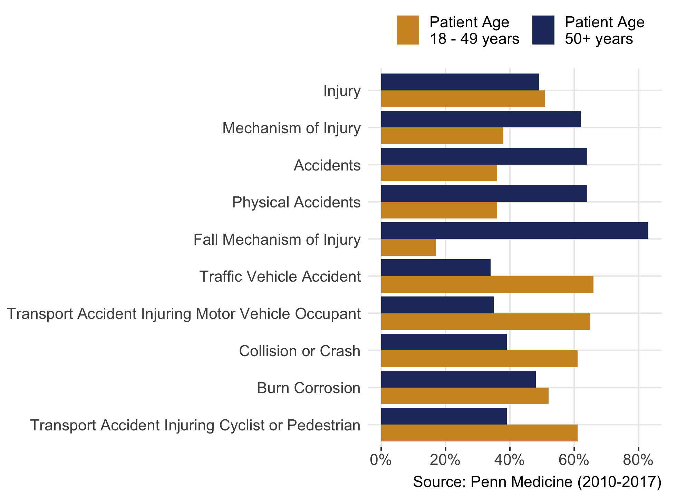
Mechanisms by age
ICD-10 code V80.010A
Animal-rider injured by fall from or being thrown from horse in noncollision accident, initial encounter
ICD-9 code E812.4
Motor vehicle traffic accident involving collision with motor vehicle injuring occupant of streetcar
Notes:
We also used these definitions to group a variety of ICD codes into injury mechanisms
The most common injury mechanisms are displayed on this slide where the gold color in the bar graph…
Of these 10 most common injury mechanisms, injuries relating to falls occurred mostly among patients in the age group 50 years and older, while traffic- and transport-related accidents occurred mostly among patients between 18 and 49 years
An example of...
Clearly there is a lot of detail captured in structured data available in the EHR
- ICD codes can be quite specific
- Can include context about the way the accident or injury happened and where
These details may not be captured reliably in data from surveys or interviews
-------
There’s a lot of detail that’s been recorded in the structured data (would be good for epi folks that haven’t worked with EHR data)
Some of the specificity would come from interviewing a person if you’re working with surveys.
“on the field, off the field” so the way the accident happened is not rich
More reliable than some of the recall in interviews
Surveyor would have to know to ask for these details and then the patient would have to remember. With a head injury!

Slide 4
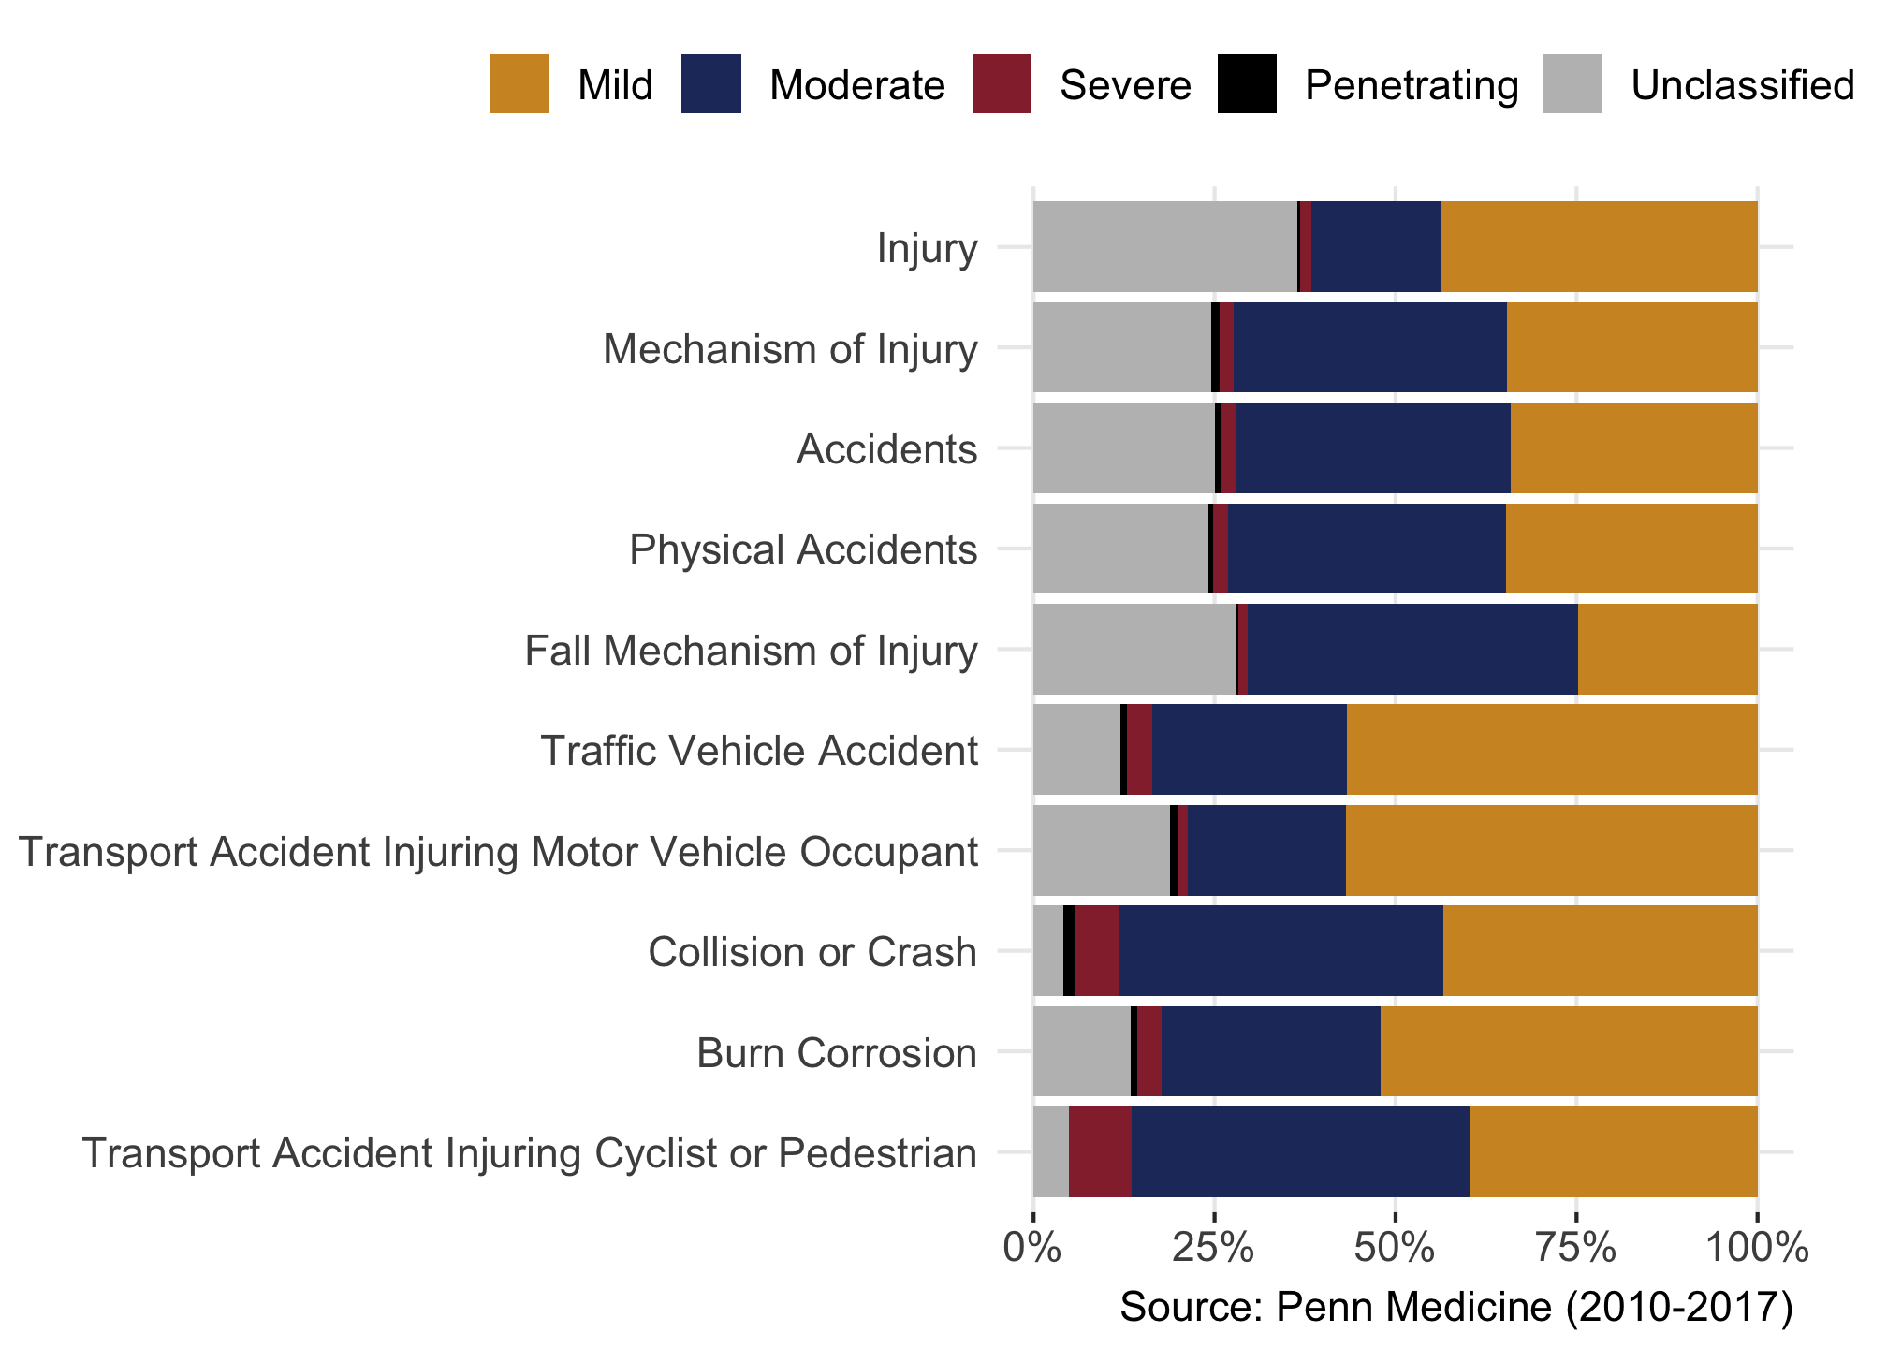
Mechanisms by severity
Mild ICD-10 code S06.0X1A
Concussion with loss of consciousness of 30 minutes or less, initial encounter
Severe ICD-9 code 801.35
Closed fracture of base of skull with other and unspecified intracranial hemorrhage, with prolonged [...] loss of consciousness, without return to pre-existing conscious level
Notes:
Again, we used the CDC and DoD definitions for TBI and TBI severity to
look at the proportion of each severity level within the different injury mechanisms
Severity levels range from Mild to Moderate to Severe and finally to Penetrating. On one end of the spectrum, we see that Mild injury codes are pretty common within each of the injury mechanisms
An example of a Mild code would be …
We can also see that out of these most common injury mechanisms,
collision or crash and transport accident injuring cyclist or pedestrian contained
the most Severe ICD codes
An example of a Severe code would be …
This information helps us paint a more complete picture of TBI and what I hope I demonstrated in this talk is the potential to leverage the richness in structured EHR data to conduct research that includes historically understudied populations, which will ultimately help us better understand the stories of patients at Penn Medicine

Slide 5
Thank you!
This work was done in partnership with Rebecca Morse & P.I. Mary Regina Boland, PhD
Slides and more at silviacanelon.com
Some support for this project provided by the Penn Injury Science Center which is an Injury Control Research Center funded by the Centers for Disease Control and Prevention (CDC; grant no.: R49CE003083)
Notes:
This work was done in partnership with Rebecca Morse and Principal Investigator Mary Regina Boland
You can find these slides and more on my personal website, silviacanelon.com
Thank you for your attention!

